Slide 1
Welcome to Minor Project

Slide 2
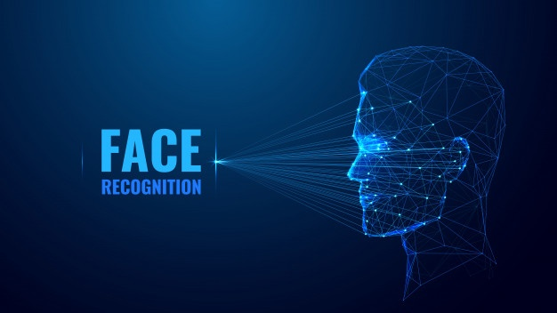

Face recognition using opencV anD PYTHON
Submitted By :
Daipayan Das - 29901219035
Sneha Maity - 29901219005
Rajat Majumder - 29901219018
Debagni Bhattacharjee - 29901219023

Slide 3
Table of Contents
Acknowledgement
Abstract
Introduction
Project Goals
Project Specification
What is OpenCV
What is face- recognition
How its work
Flowchart
Project Implementaion
Results and Snapshots
Advantage disadvantage
Conclusion
Future Scope
Summary

Slide 4
Acknowledgement
Someway or somehow we have all had to suffer because of the curent pandemic situation. Our mentor Bijoyini Mam has been the pillar of strength for us. Her guidance and inputs at each stage of the project were invaluable . we are thankful to her for making things so clear.

Slide 5
Abstract
Face Recognition is a computer application that is capable of detecting, tracking, identifying or verifying human faces from an image or video captured using a digital camera. In this project, we are using numpy , face recognition python library,openCV,os module.
F

Slide 6
Instroduction
Facial recognition is a way of identifying an individual's identity using their face. Facial recognition systems can be used to identify people in photos, videos, or in real-time.Complex and largely software based technique.
Applications of Face Recognition :
Numerous applications :
Looking mechanism for devices
Prevention of retail crime
Finding missing people
Identify people on social media platforms

Slide 7
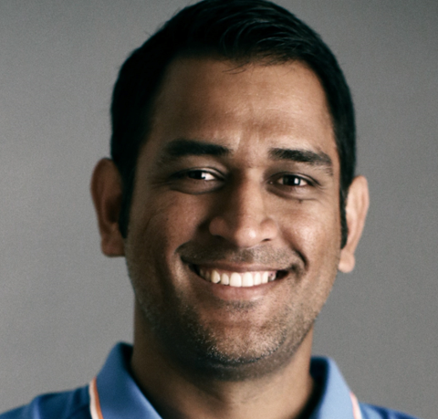
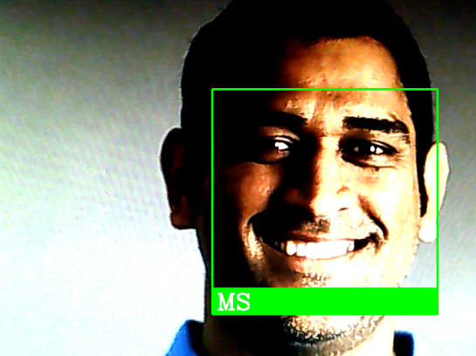
Project Goal
The main project goal is to detect and identify the human faces and show their names using openCV and face recognition library and some python library

Slide 8
Project Specification
Operating System : windows 10
Hardware : Webcamera
Programming language : Python
computer vision library : opencv
Face detect library : face-recognition
others library : numpy
Ide : Pycharm

Slide 9

What is OpenCV
Open source Computer Vision library
Orginally developed by intel
Has more than 2500 optimized algorithms
Its is written in C++
Supports multiple platforms C++,Python ,Java
In this project we are using openCV version 4.5.5

Slide 10
What is Face Recognition
A facial recognition system uses biometrics to map facial features from a photograph or video. It compares the information with a database of known faces to find a match. Facial recognition can help verify a person's identity.
How its work ?
Face recognition systems use computer algorithms to pick out specific, details about a person's face. These details, such as distance between the eyes or shape of the chin, are then converted into a mathematical representation and compared to data on other faces collected in a face recognition database.

Slide 11
Flowchart representation of Facial detection program
Start
Input image
Detect face in image
Draw rectangle around face and show their names
Output image

Slide 12


Project Implementaion
To implement face recognition using OpenCV and Python.
We have to install these library
1. OpenCV
2. dlib
3. Face_recognition
4. numpy
dlib is a modern C++ toolkit containing machine learning algorithms.
face_recognition library is super easy to work with and we will be using this in our code. First, remember to install dlib library before you install face_recognition.
Numpy is a set of array
Installing OpenCV, dlib, and face recognition in terminal :
pip install dlib
pip install numpy

Slide 13
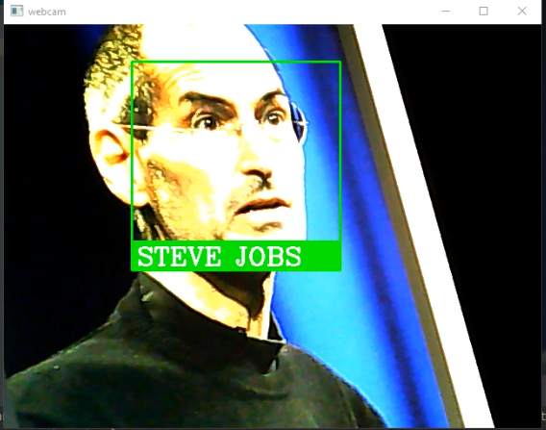
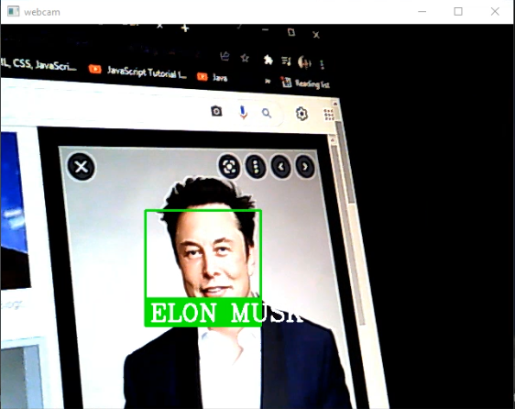
Result and Snapshots
This is the output of our code which firstly detects faces then identify from a webcamera .
Snapshots 1 : Snapshots 2 :

Slide 14


Slide 15
Advantages :
Face recognition is very easy to use
Face recognition is more user-friendly.
It can be used to unlock devices.
Harder to hide from criminals.
It May help to identify a fake passport.
Disadvantages :
Facial recognition can be expensive.
Technology is not mature yet.
Can be misused by the government.

Slide 16
Conclusion
we are very happy for contributing the project, thank you for give us opportunity learn new experience with you for minor project ,we are very obliged to get your instructions on project ,thanking you Bijoyini Bagchi and all rest ciem teachers.
Thanking You

Slide 17
Summary
In this tutorial, you will learn how to use OpenCV to perform face recognition. To build our face recognition system, we’ll first perform face detection, extract face embeddings from each face using deep learning, train a face recognition model on the embeddings, and then finally recognize faces in both images and video streams with OpenCV.

Slide 18
Future Scope
Facial recognition technology is helping to reduce the spread of viruses like coronavirus by reducing the number of touchpoints in clinical environments and while this technology is being used to tackle the pandemic.

Slide 19
THANK YOU…

